Slide 1


Slide 2
About Today…
PostgresQL
Configuration
Connection with Express.js

Slide 3
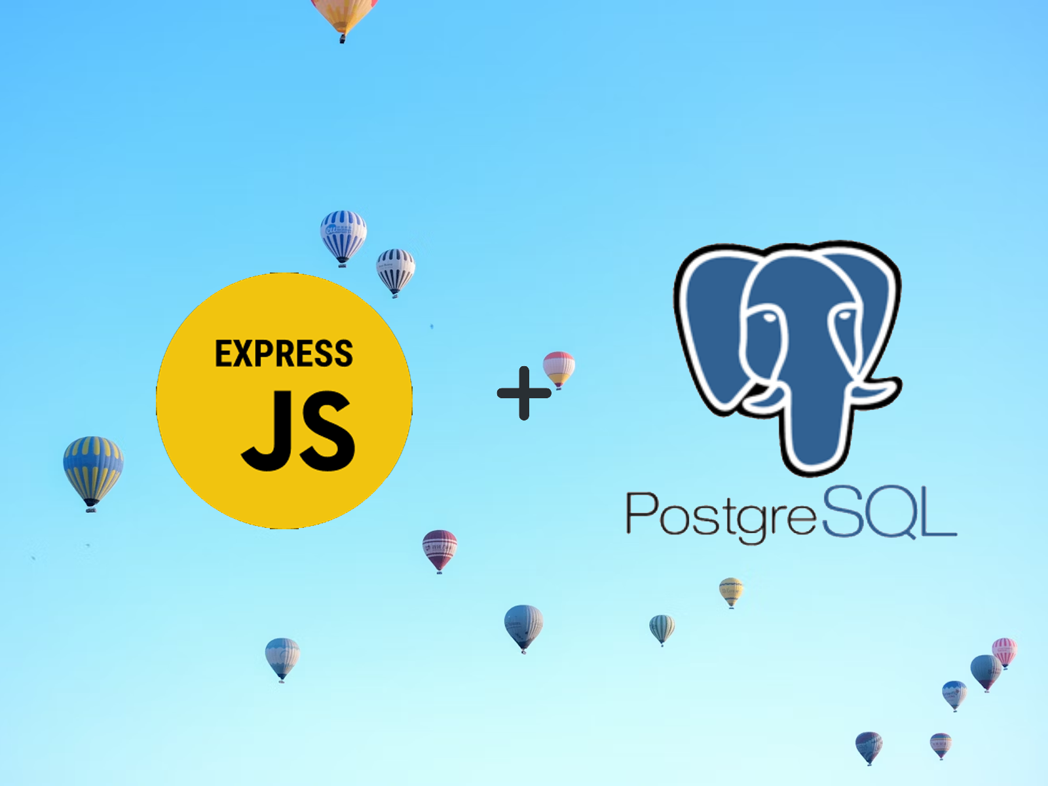

Slide 4

Configuring PostgreSQL
Accessing PostgreSQL
Open the terminal and run :
Creating a New Database
Creating a New User
Granting Privileges

Slide 5

Setting Up Express.js
Initial Setup
Create a new directory for your project: mkdir myexpressapp
Navigate to the directory: cd myexpressapp
Initialize a new Node.js project: npm init -y
Install Express and pg Library
Create app.js File

Slide 6
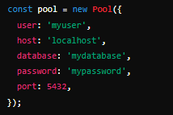
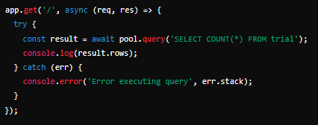

Connecting Express to PostgreSQL
Configure PostgreSQL Connection
Create a Simple Route
Start the Server

Slide 7

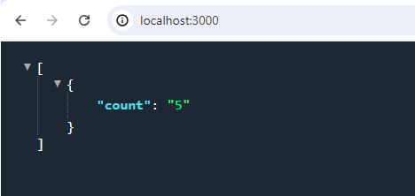
Testing the Connection
Start Your Express Server
Test in Browser
Open http://localhost:3000 in your browser

Slide 8

Which library is used to connect PostgreSQL with Express.js?
pg
What is the default port number for PostgreSQL?
5432
Which command initializes a new Node.js project?
npm init -y
What type of response does the Express.js route normally send?
Json, html, plain text

Slide 9

Task
Create an express server which confirms connection with PostgreSQL database

